Slide 1

Netflix Dataset Analysis
[ NIMISHA RAWAT ]
[ INTERNSHIP_172663295366ea53f910591 ]

Slide 2

PROBLEM STATEMENT
Netflix has become one of the most prominent global streaming platforms, continuously expanding its library with a mix of original productions and licensed content. However, with growing competition from platforms like Amazon Prime, Disney+, and regional OTT providers, Netflix must strategically analyze its content catalog to identify strengths, gaps, and opportunities.
The specific problem to be addressed in this project is 'Content Trends Analysis for Strategic Recommendations'. The aim is to uncover how Netflix’s content distribution (Movies vs. TV Shows, genres, and country contributions) has evolved over the years. This will enable the identification of key genres, audience preferences, and strategic insights into global content expansion.

Slide 3
Project Description
This project focuses on analyzing the Netflix dataset to uncover trends, patterns, and insights about the content available on the platform. Using Python-based data analysis and visualization techniques, the project explores various aspects such as the distribution of movies and TV shows, content growth over the years, genre popularity, regional contributions, and audience ratings.
Objective
To perform exploratory data analysis (EDA) on the Netflix dataset and derive meaningful insights about:
Content type distribution (Movies vs. TV Shows)
Most popular genres and categories
Content production trends over time
Country-wise contribution to Netflix’s library
Rating and maturity classification trends
Duration analysis of movies
Director and cast activity
Outcome
The project demonstrates how data-driven analysis can help understand content trends and business strategies in the streaming industry. It highlights Netflix’s evolution, audience preferences, and global content diversity through clear visualizations and summarized insights.

Slide 4

WHO ARE THE END USERS?
The Netflix Data Analysis Project is useful for:
Business Analysts & Data Scientists – to identify viewing trends and support data-driven decisions.
Netflix Content Teams – to plan content acquisition, production, and regional strategy.
Researchers & Academics – to study global streaming and entertainment trends.
Marketing Professionals – to target audiences based on content preferences.
Students & Learners – to practice real-world data analysis and visualization skills.

Slide 5

Technology Used
Tools & Technologies Used
Python (Pandas, NumPy) – for data manipulation and cleaning
Matplotlib & Seaborn – for data visualization
Jupyter Notebook / Google Colab – for analysis and presentation
CSV Dataset – containing Netflix’s movie and TV show metadata

Slide 6
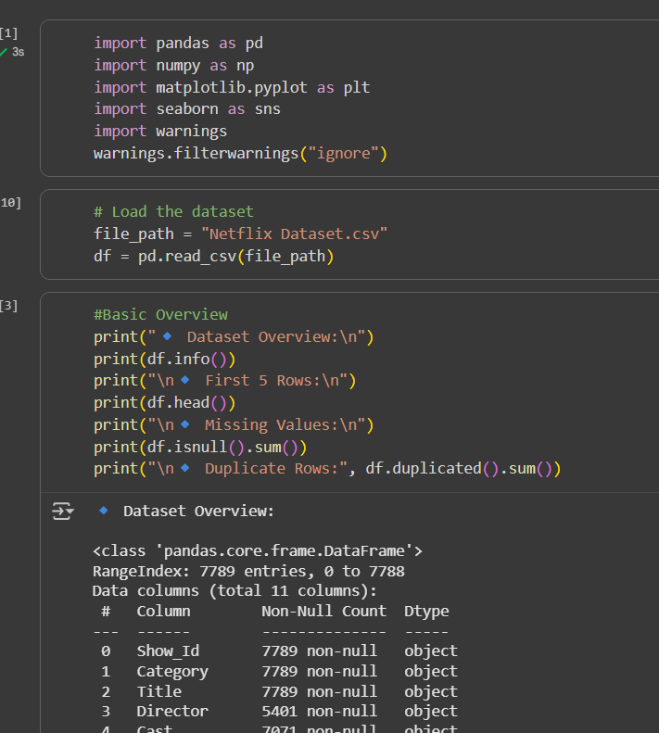
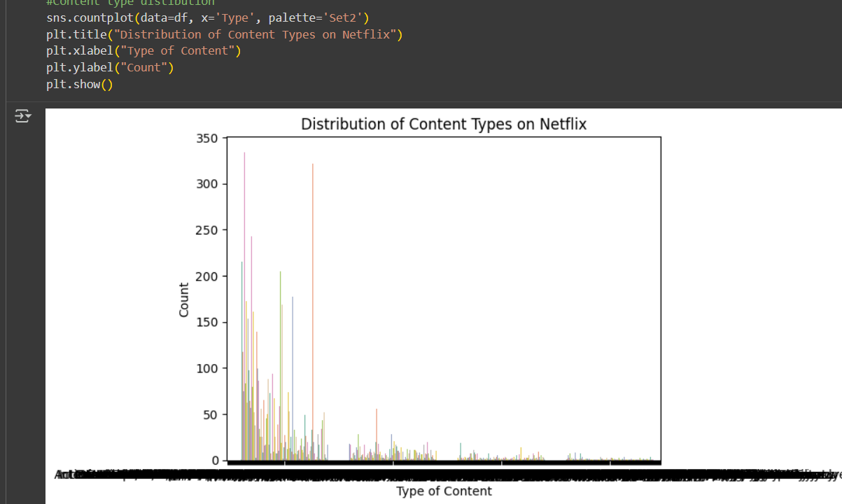
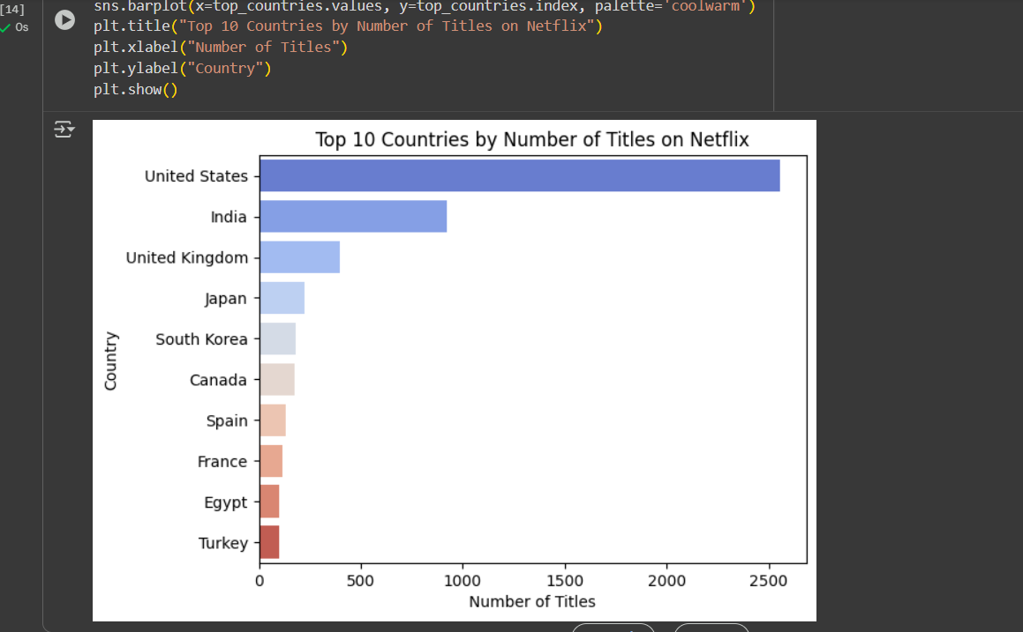
RESULTS1

Slide 7
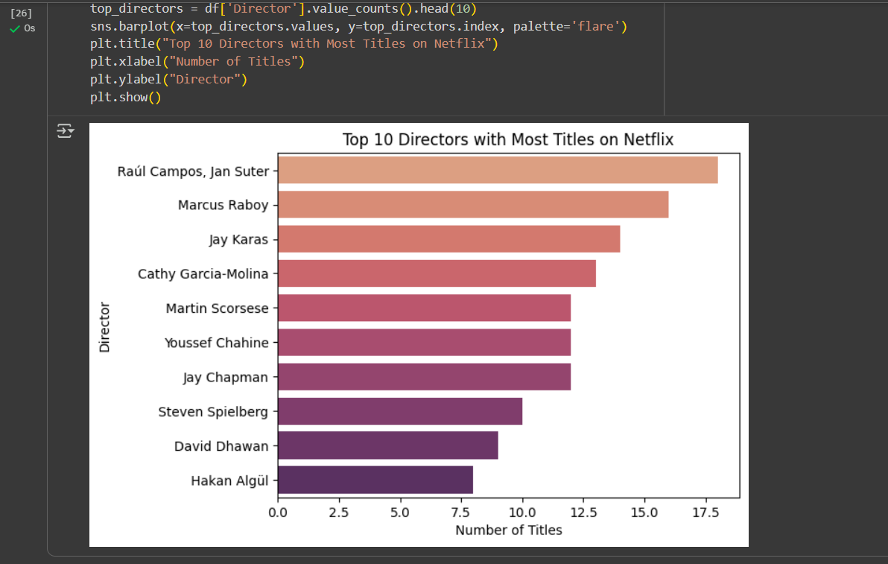
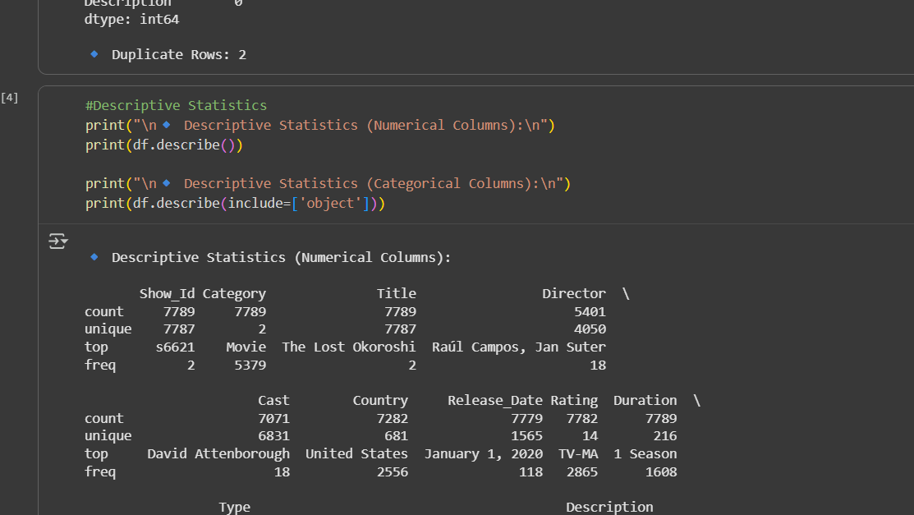
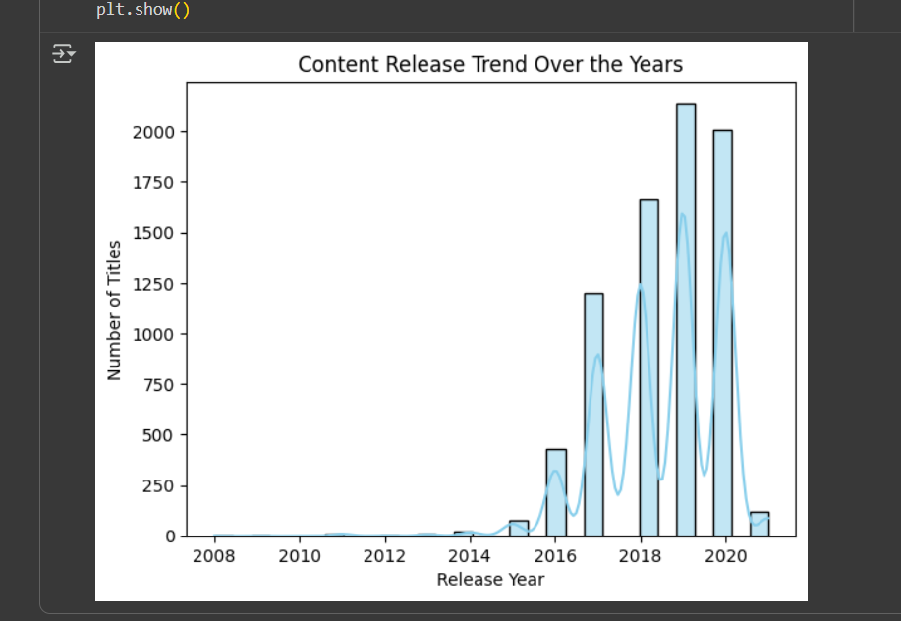
RESULTS2

Slide 8
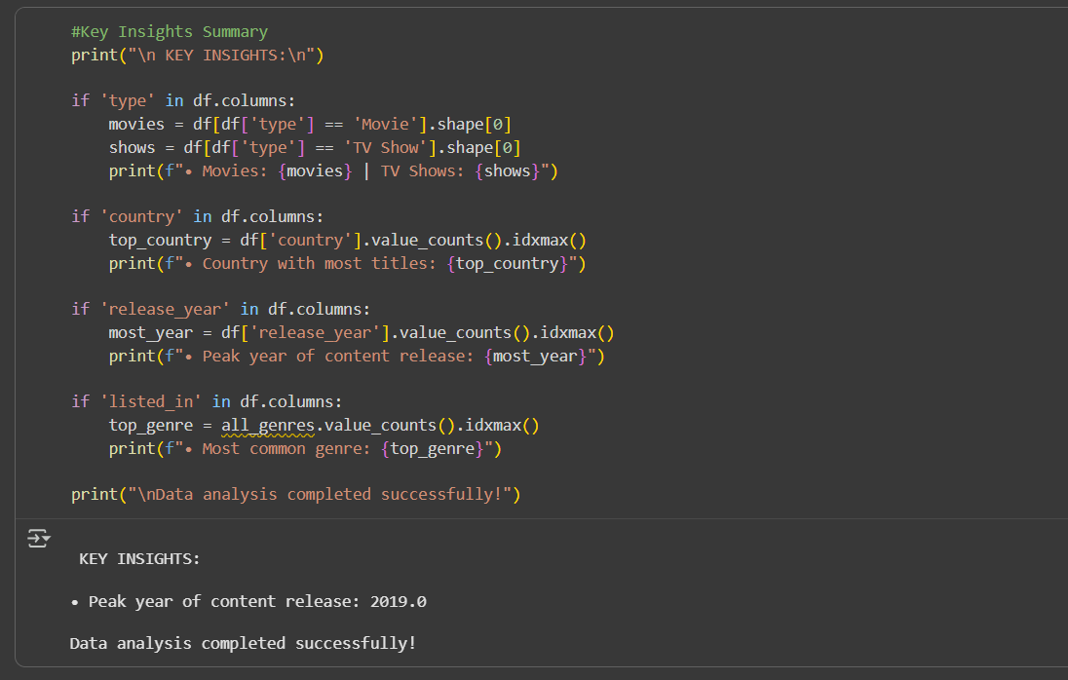
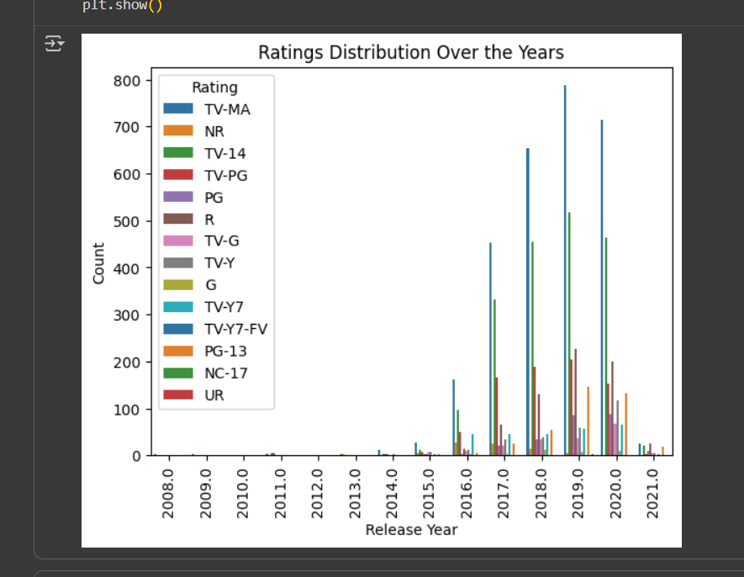
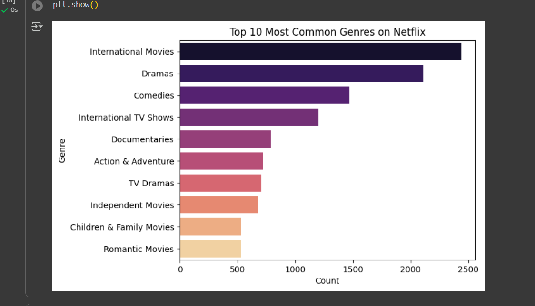
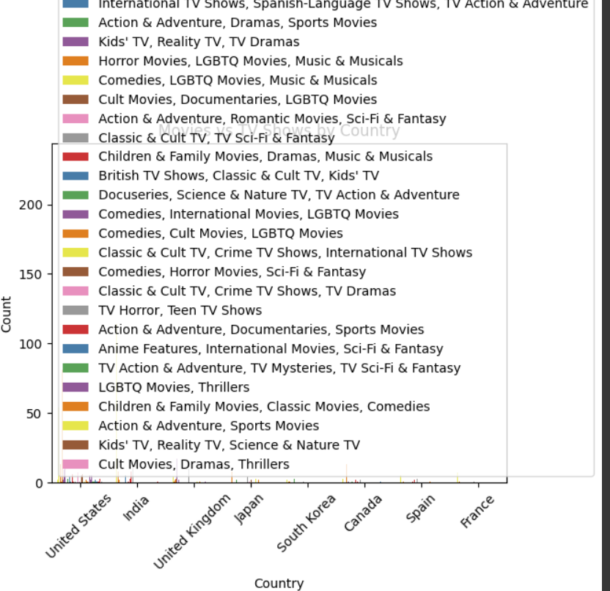
RESULTS3

Slide 9
GitHub repository
[ https://github.com/Nimisha2136/Netflix-Dataset-Oct_2025.git ]

Slide 10

Getting started with Basics of Python Certificate

Slide 11
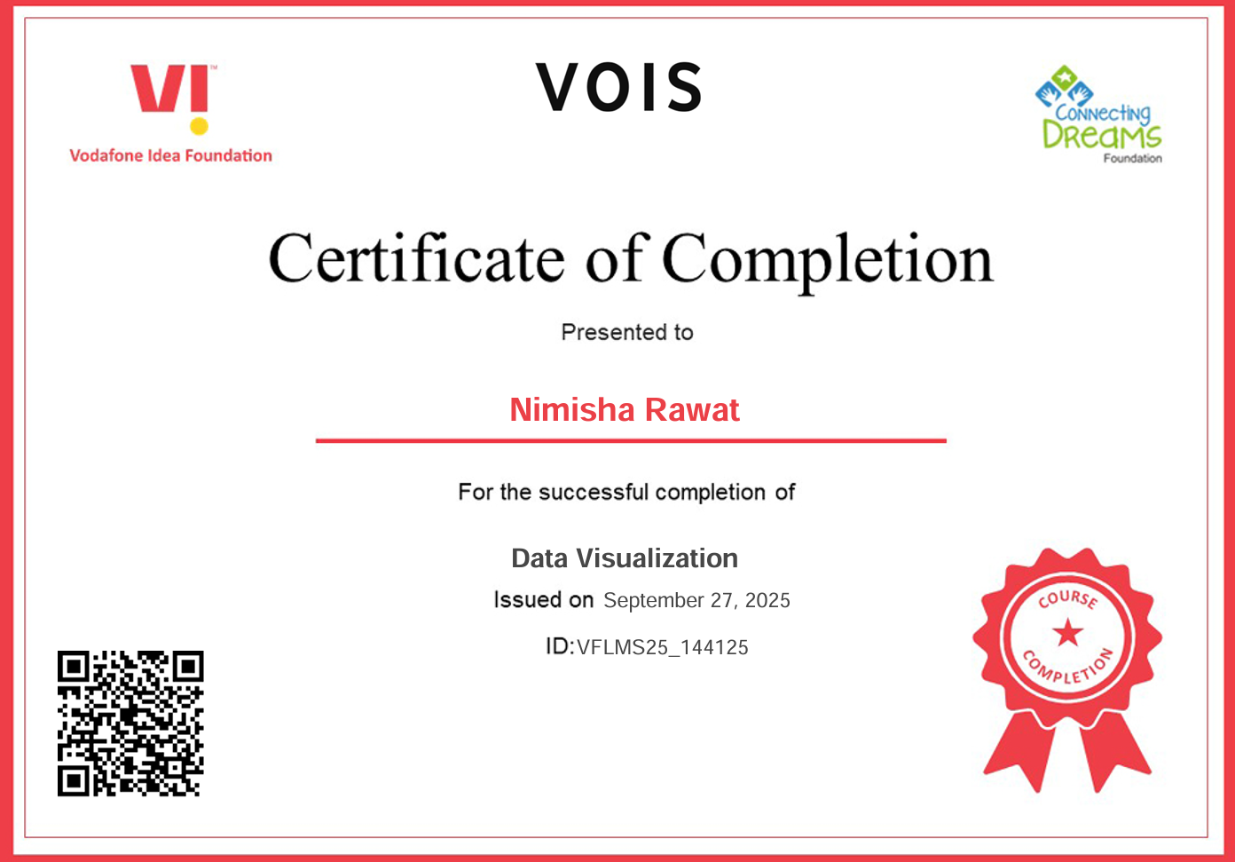
Data Visualization Certificate

Slide 12
Thank you
.
.

